Slide 1
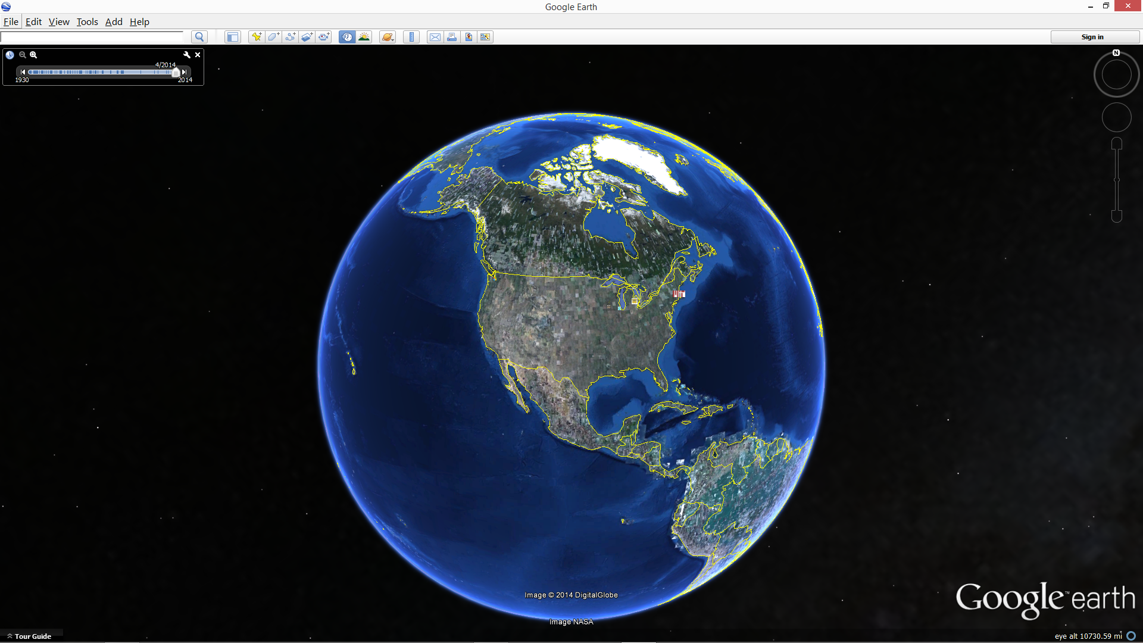
Aaron Vesperman
Why
I’m
Here
Notes:
Good afternoon, my name is Aaron Vesperman. I’m here today because I love this world we live in. Let me briefly share with you my journey to get here.
<number>

Slide 2
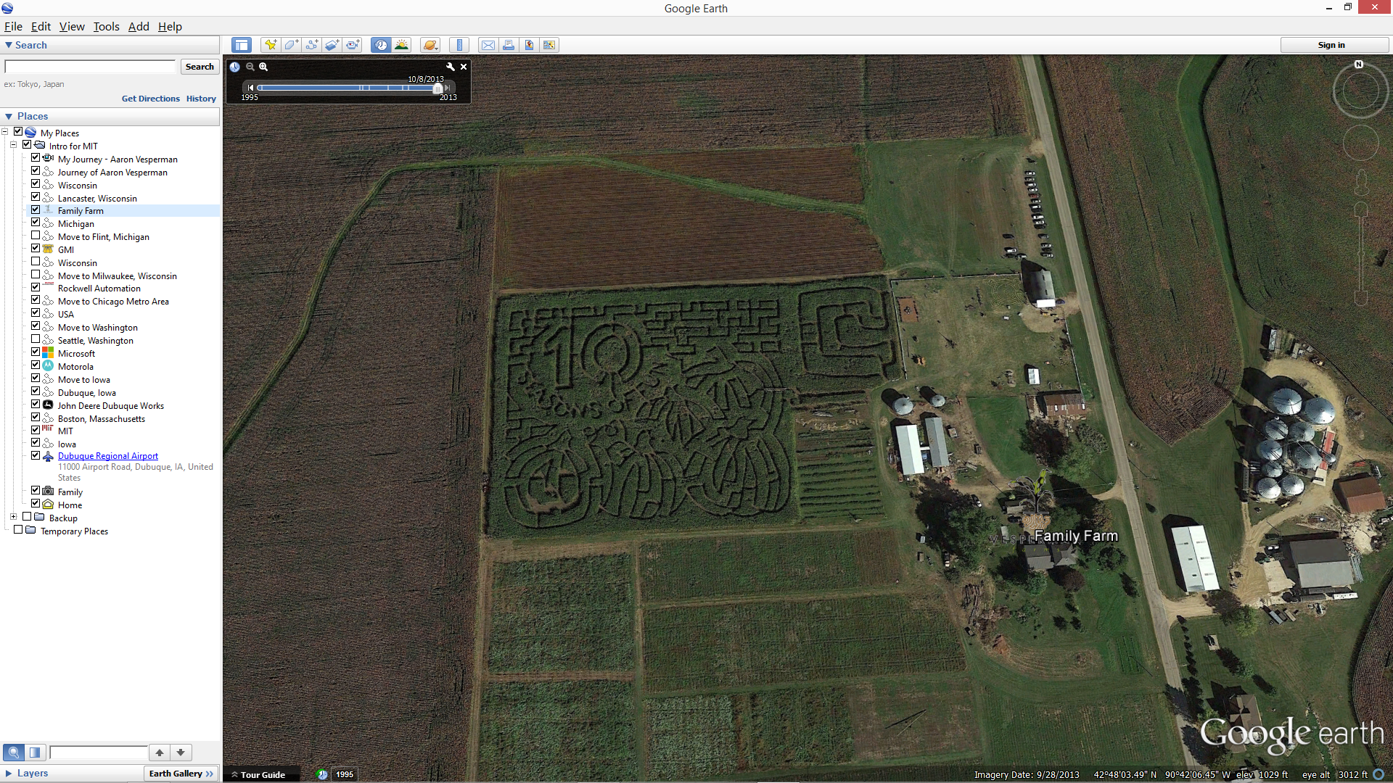
Aaron Vesperman
Where I’m From
Notes:
I grew up on farm in rural Wisconsin. My parents raised hogs and beef cattle while growing corn, soy beans and other vegetables. I helped with chores and enjoyed harvest times when sweet corn and strawberries were in season. I learned about computers when my dad purchased an Apple II to manage the farm. My brother and parents now operate a corn maze and pumpkin patch on the farm which is fun. Their technology use has grown to include computers that are much smaller, faster, and capable than the Apple II -including ipads for point of sale purchases and gps guided tractors. It’s a amazing to see the increase in technology use on farms and how far we’ve come since the 1980’s.
<number>

Slide 3
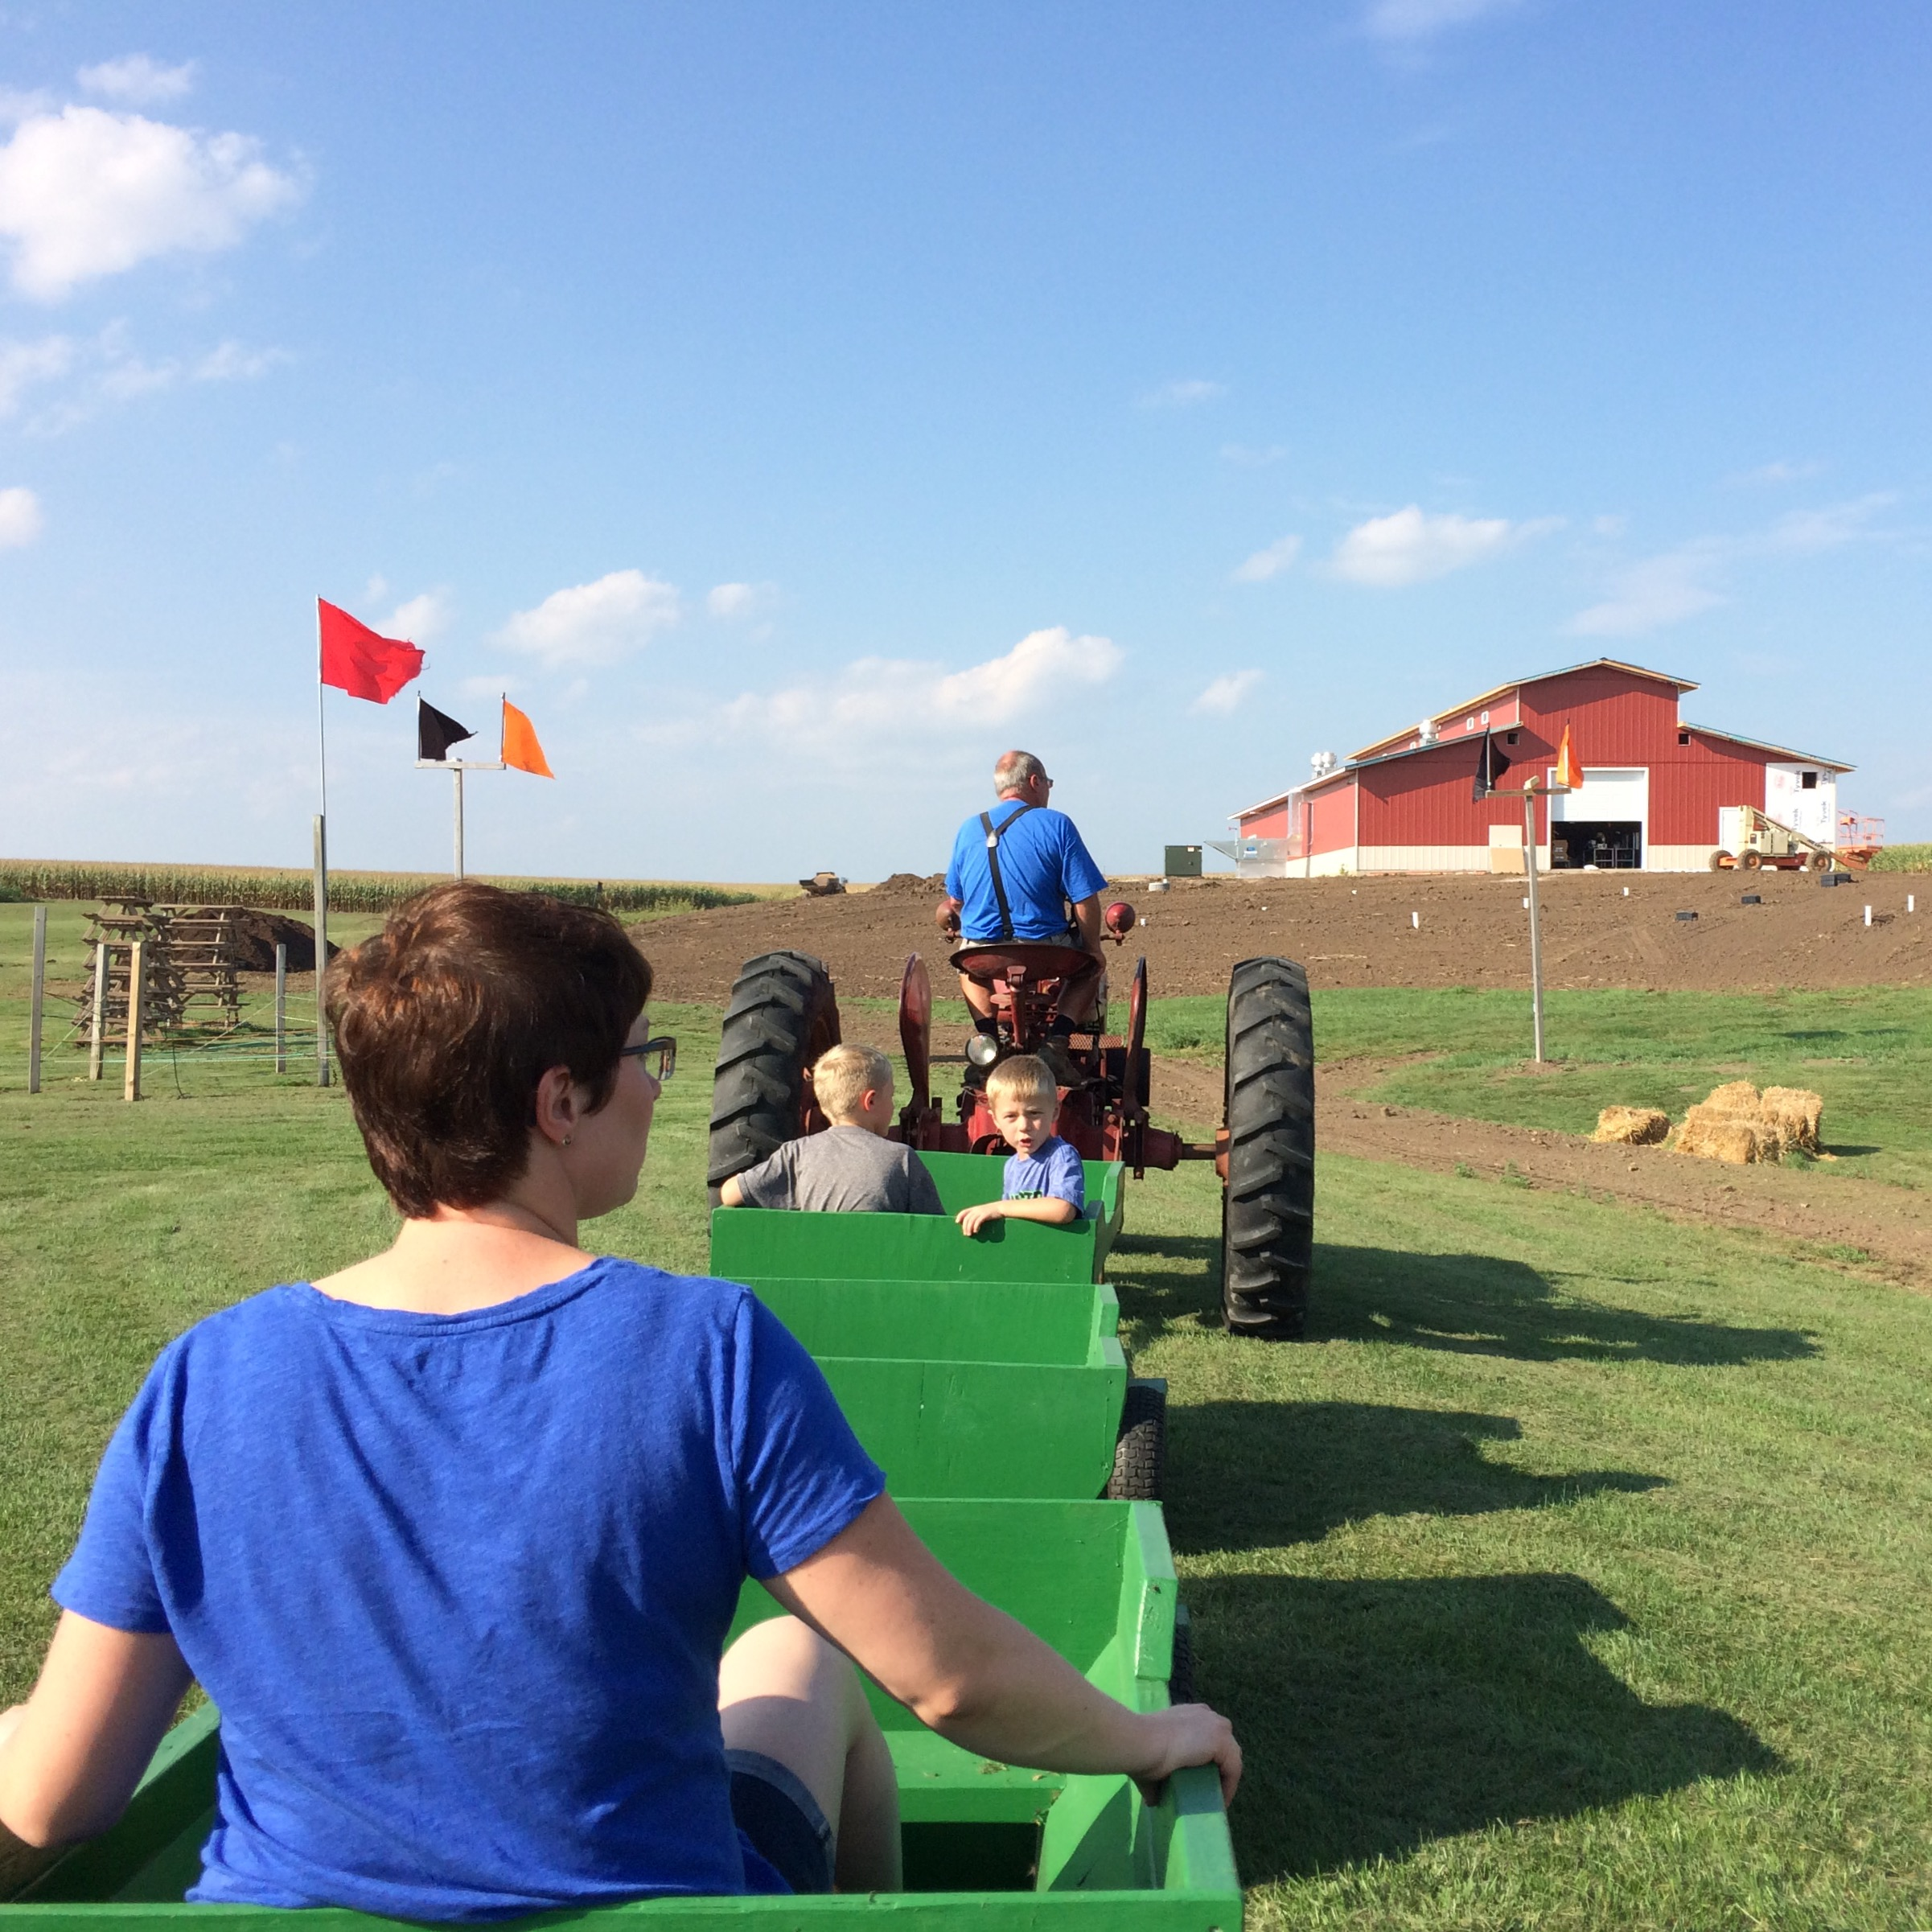
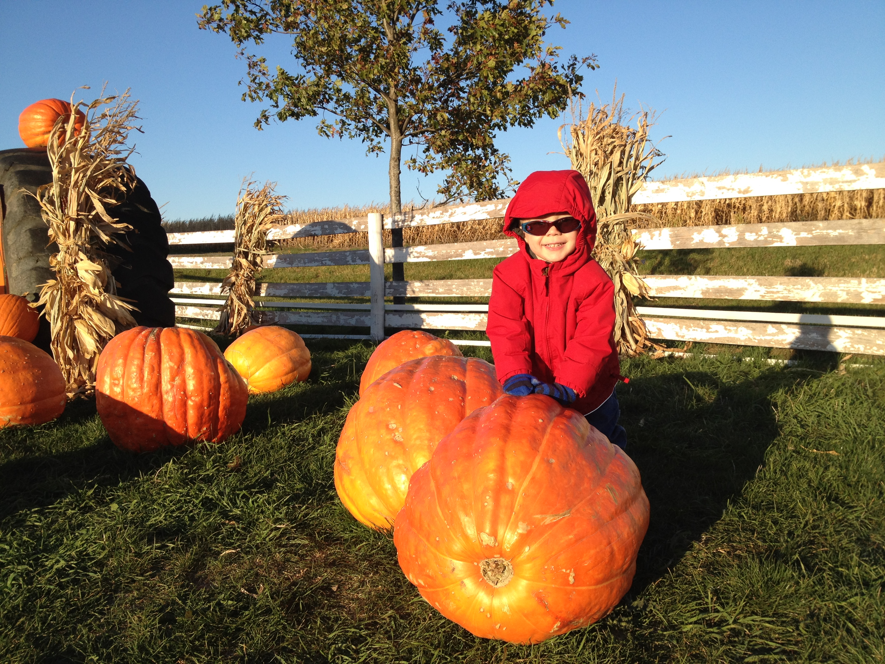
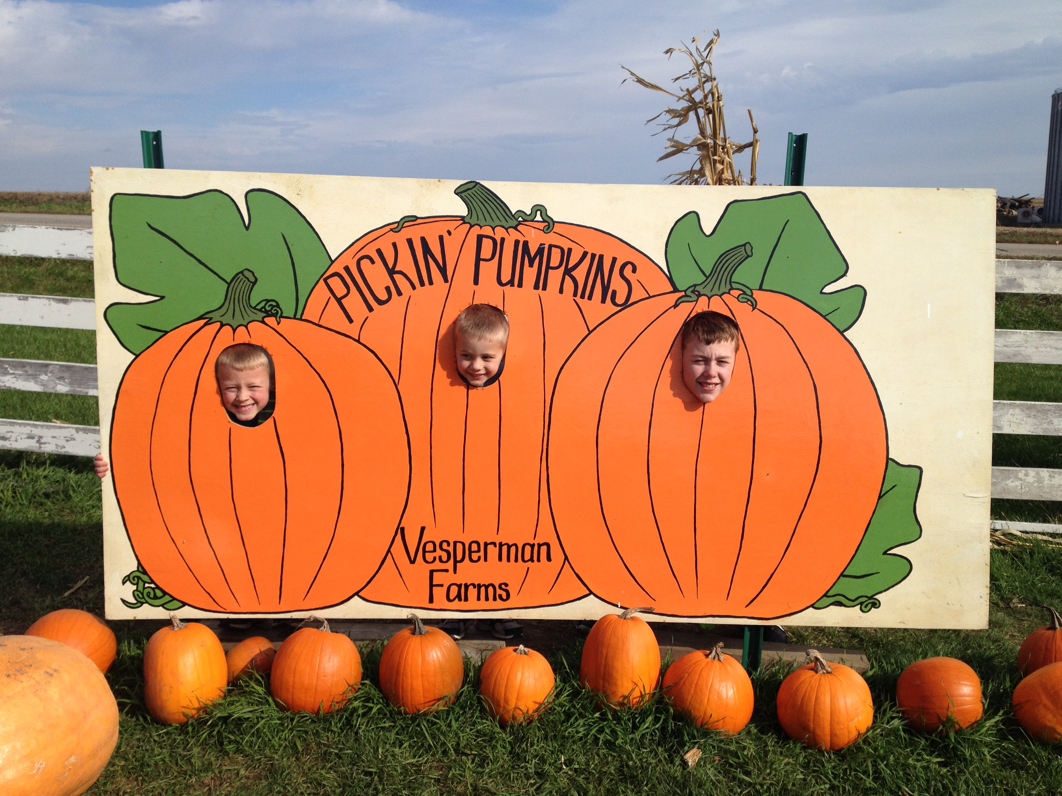
Aaron Vesperman
Where I’m From
Notes:
I grew up on farm in rural Wisconsin. My parents raised hogs and beef cattle while growing corn, soy beans and other vegetables. I helped with chores and enjoyed harvest times when sweet corn and strawberries were in season. I learned about computers when my dad purchased an Apple II to manage the farm. My brother and parents now operate a corn maze and pumpkin patch on the farm which is fun. Their technology use has grown to include computers that are much smaller, faster, and capable than the Apple II -including ipads for point of sale purchases and gps guided tractors. It’s a amazing to see the increase in technology use on farms and how far we’ve come since the 1980’s.
<number>

Slide 4
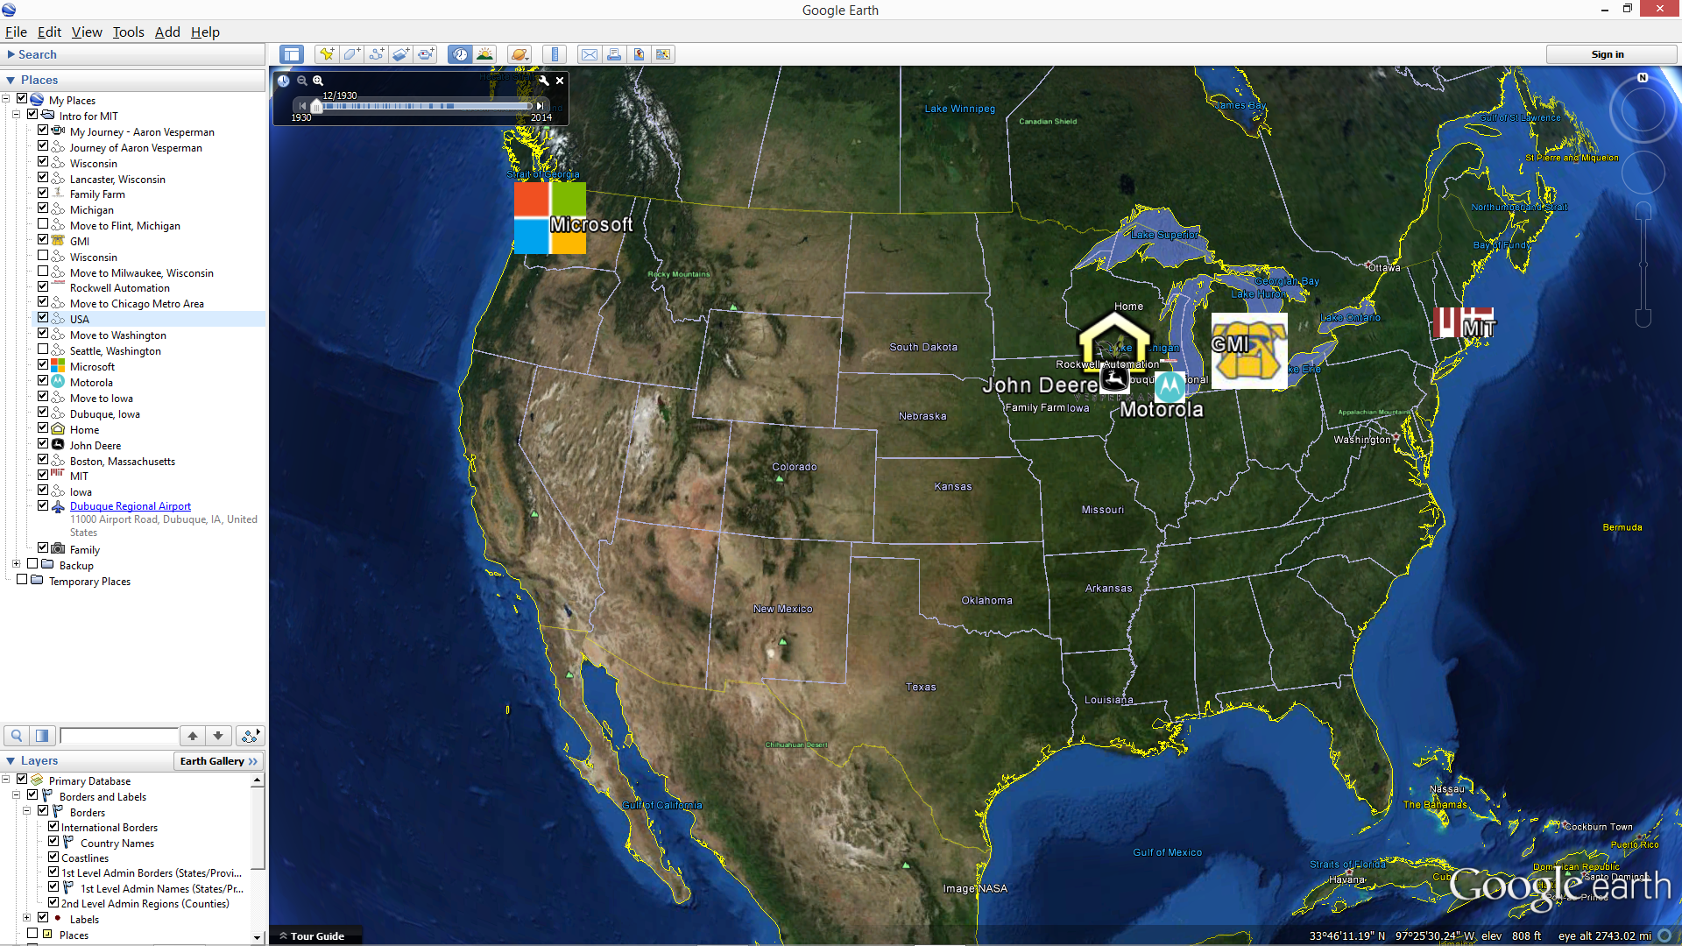
Aaron Vesperman
Where I’ve Been
Notes:
After finishing college at General Motors Institute in Michigan, I was privileged to work at great technology companies including Rockwell Automation, Motorola, Microsoft and recently John Deere. Each was an opportunity to make a safer, more productive or more efficient solution for people. At John Deere I’m building technology to help feed, clothe and shelter the world. I’m proud to work for a company that is committed to those linked to the land.
<number>

Slide 5
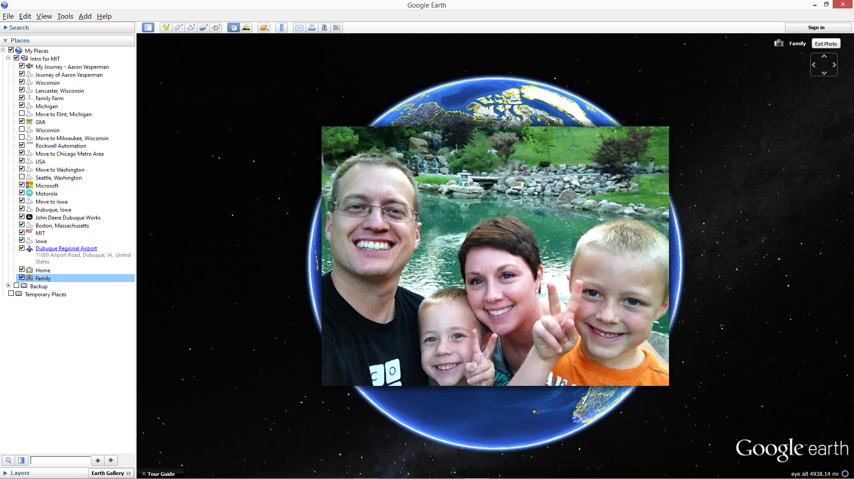
Aaron Vesperman
Why
I’m
Here
Creating a better world for our families.
Notes:
And this is why I’m here at MIT today. I want to learn new skills to create a better world for my family and future generations to enjoy.
<number>

Slide 6
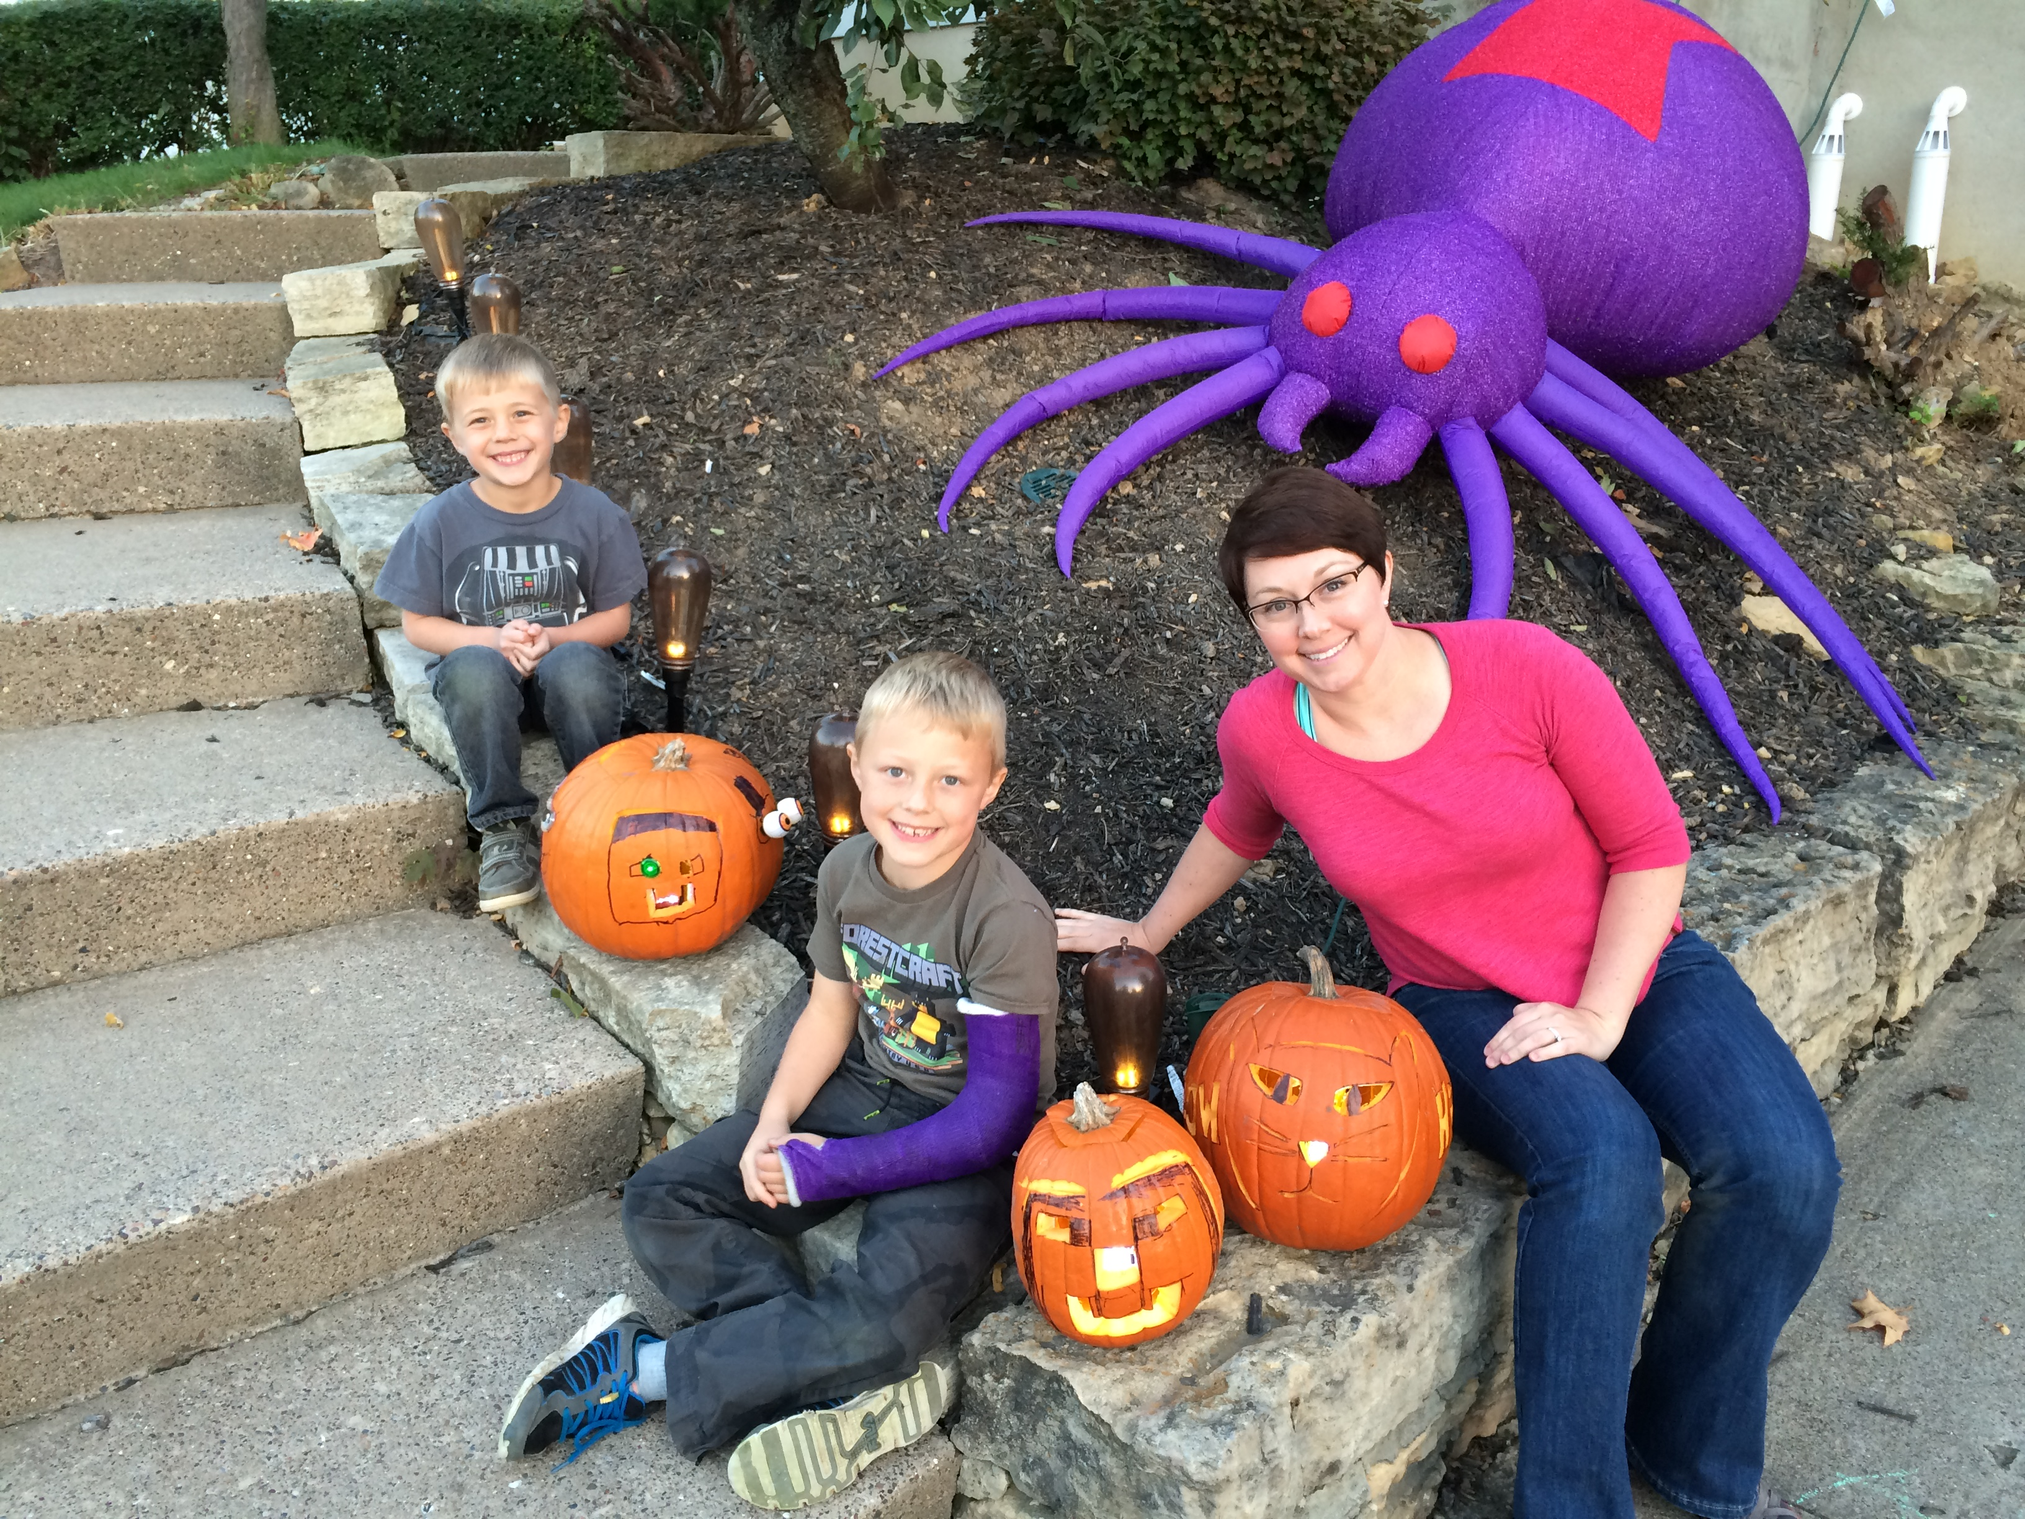
What's next?

Slide 7
Design Challenge

